Slide 1

WEEK 03 · LECTURES 5 & 6
MULTIMEDIA PRODUCTION
Implications of Learning Theories and Integrated Models
Cognitive Load Theory · Integrated Models · 4C/ID Model

Slide 2
WEEK 03 · LECTURE 5 & 6
What We Will Learn Today
01
02
03
Why Theories Matter
Cognitive Load Theory
Integrated Models
Understanding learning problems and why we need theories to design better multimedia.
How the brain processes information and three types of cognitive load.
How text and pictures work together to create stronger learning.
02

Slide 3

WEEK 03 · LECTURE 5 & 6
Have You Ever Felt Lost in a Lesson?
Too many slides with endless text confuse students
Videos that move too fast leave learners behind
Complicated diagrams without explanation create frustration
When content is poorly designed, learning becomes harder
Good multimedia design starts with understanding the brain
EXPLANATION
When students face poorly designed content, their brain works too hard just to understand the layout instead of focusing on the actual lesson.
REAL-WORLD EXAMPLE
A YouTube tutorial with 50 slides of text and no images — viewers click away within 30 seconds.
03

Slide 4
WEEK 03 · LECTURE 5 & 6
The Brain Has Limited Processing Power
Our brain can only handle a small amount of new info at once
Imagine your brain like a small table — it can only hold a few items
When you overload it, things fall off (you forget)
Simple, clear content works better than complex, busy content
Understanding this helps us design better multimedia
BRAIN CAPACITY DIAGRAM
Working Memory (Limited Space)
Intrinsic
Extraneous
Germane
When full → information is lost!
EXPLANATION
Just like a computer slows down with too many programs open, our brain slows down when given too much information at once.
REAL-WORLD EXAMPLE
Long-Term Memory (Unlimited Storage)
A mobile learning app with clean, one-concept-per-screen design vs. one that crams everything onto one page.
04

Slide 5
WEEK 03 · LECTURE 5 & 6
Three Big Ideas to Solve Learning Problems
This lecture covers three powerful tools for better design
Cognitive Load Theory — how to reduce mental effort
Integrated Models — how text and pictures work together
4C/ID Model — how to design complete learning experiences
These theories help us create content that actually teaches
Cognitive Load Theory
Manage the brain's limited capacity by reducing unnecessary mental effort in multimedia design.
Integrated Models
Combine text and visuals effectively so they support each other rather than compete for attention.
EXPLANATION
Think of these theories as a toolbox. Each tool solves a different problem in multimedia design. Together, they help you build lessons that work.
4C/ID Model
Design complete learning experiences with real tasks, support, guidance, and repeated practice.
REAL-WORLD EXAMPLE
E-learning platforms like Coursera and Khan Academy use all three ideas to design their courses.
05

Slide 6

01
COGNITIVE LOAD THEORY
Understanding How the Brain Processes Information
Part 1: Implications for Multimedia Design
06

Slide 7
WEEK 03 · LECTURE 5 & 6
What Is Cognitive Load Theory?
Cognitive Load Theory (CLT) says our brain has limited mental space
John Sweller developed this theory in the 1980s
It explains why some lessons feel easy and others feel hard
The goal is to design content that matches how our brain works
When we respect the brain's limits, learning improves
THE BACKPACK ANALOGY
Your Brain = A Backpack
Hard Topic
Bad Design
Good Effort
EXPLANATION
CLT is like knowing the weight limit of a backpack. If you pack too much, you cannot carry it. If you pack smartly, everything fits.
Pack Smart = Learn Better
REAL-WORLD EXAMPLE
A PowerPoint with 20 bullet points overwhelms students; the same content split into 4 slides is much easier to learn.
07

Slide 8
WEEK 03 · LECTURE 5 & 6
Three Types of Cognitive Load
Intrinsic Load — comes from the difficulty of the topic itself
Extraneous Load — comes from poor design and distractions
Germane Load — the good mental effort that helps learning
Good design reduces extraneous load and manages intrinsic load
This makes room for germane load — the learning that matters
INTRINSIC
EXTRANEOUS
GERMANE
Topic difficulty
Cannot be removed
Break into parts
Bad design
Can be removed
Clean it up
Good effort
Helps learning
Make room for it
EXPLANATION
Think of intrinsic as the weight of essential items, extraneous as packing junk you don't need, and germane as organizing everything efficiently.
Essential weight you must carry
Junk that wastes space
Effort that builds understanding
REAL-WORLD EXAMPLE
A cooking video: intrinsic = recipe complexity, extraneous = loud music, germane = clear step-by-step visuals.
08

Slide 9
WEEK 03 · LECTURE 5 & 6
Intrinsic Load — The Difficulty of the Content
Some topics are naturally harder than others
Learning quantum physics has higher load than learning colors
You cannot make the topic easier, but you can break it into parts
Teach one small piece at a time instead of everything at once
This is why good lessons progress from simple to complex
SIMPLE TO COMPLEX PROGRESSION
1
Learn basic concepts first
2
Practice with guided examples
EXPLANATION
3
Tackle complex problems
Intrinsic load is like the weight of necessary items in your backpack. You cannot leave them behind, but you can carry them one at a time.
4
Master the full skill
REAL-WORLD EXAMPLE
Khan Academy teaches math by breaking complex problems into small, manageable steps with video explanations.
09

Slide 10
WEEK 03 · LECTURE 5 & 6
Extraneous Load — Bad Design Wastes Brain Power
Extraneous load comes from how content is presented
Too much text, confusing layouts, and unnecessary animations add load
This is the ONLY type of load we can completely remove
Clean design, clear labels, and simple layouts reduce this load
Every bit of extraneous load removed makes room for learning
BAD DESIGN
GOOD DESIGN
Too much text
Short, clear text
Busy background
Clean background
Crazy animations
Subtle transitions
5+ fonts used
1-2 fonts max
EXPLANATION
No visual hierarchy
Clear visual hierarchy
Extraneous load is like packing items you don't need. They take up space and make your backpack heavier without adding value. Remove them.
REAL-WORLD EXAMPLE
A slide with animated GIFs, 5 different fonts, and a busy background distracts from the actual message.
10

Slide 11
WEEK 03 · LECTURE 5 & 6
Germane Load — The Good Kind of Mental Effort
Germane load is the mental work that actually helps you learn
It happens when you connect new information to what you know
Good multimedia design creates space for germane load
By reducing extraneous load, we free up mental space for this
This is where deep understanding and memory building happen
BRAIN CONNECTIONS DIAGRAM
Prior Knowledge
New Info
Connection
Understanding
Memory
EXPLANATION
Germane load is like organizing your backpack efficiently. It takes effort, but it helps you find things later and carry everything better.
Deep Learning
REAL-WORLD EXAMPLE
An interactive quiz after a video lesson helps students connect new knowledge to what they already know.
11

Slide 12
WEEK 03 · LECTURE 5 & 6
How to Reduce Cognitive Load in Multimedia
Use simple layouts with plenty of white space
Present one concept at a time, not multiple ideas together
Use clear headings and visual hierarchy to guide attention
Replace long text with diagrams and visuals where possible
Always ask: "Does this element help learning or distract?"
BEFORE vs AFTER
BEFORE
AFTER
EXPLANATION
Every element on your slide should earn its place. If it does not help learning, remove it. Simple is always better.
Key principle: Remove anything that does not directly support learning. Less is more.
Replace text walls with visuals and clear hierarchy.
REAL-WORLD EXAMPLE
Apple's product presentations use minimal text and large visuals — one idea per slide, maximum impact.
12

Slide 13
WEEK 03 · LECTURE 5 & 6
The Modality Effect — Use Both Ears and Eyes
People learn better when information comes through eyes AND ears
Instead of reading long text, use narration with visuals
This splits the load between visual and auditory channels
Both channels work together, so learning becomes more effective
But do not read exactly what is on screen — that creates redundancy
DUAL-CHANNEL PROCESSING
Visual
Auditory
Brain
Better Learning Together
EXPLANATION
Think of it as using two lanes on a highway instead of one. Traffic flows better when spread across both visual and auditory channels.
Tip: Show visuals on screen while narrating explanations. Do NOT put full sentences on screen and read them aloud.
REAL-WORLD EXAMPLE
TED-Ed videos combine animated visuals with voice narration — viewers learn more than reading text alone.
13

Slide 14
WEEK 03 · LECTURE 5 & 6
The Redundancy Effect — Do Not Repeat Yourself
Reading text while hearing the same words hurts learning
It overloads the verbal processing channel
Choose EITHER text on screen OR narration, not both
If you use text, keep it short and let narration explain
This is one of the most common mistakes in multimedia design
OVERLOADED CHANNEL
BAD: Full text on screen + narrator reading the exact same words
Verbal Channel Overloaded!
EXPLANATION
Imagine two people talking to you at the same time saying the same thing. It is confusing and wastes your attention.
GOOD: Keywords on screen + narrator explains in full detail
REAL-WORLD EXAMPLE
A training video that shows keywords on screen while the narrator explains the concept in full sentences works well.
14

Slide 15
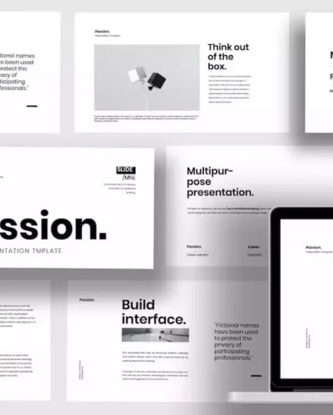
02
INTEGRATED MODELS
How Text and Pictures Work Together
Part 2: Text + Picture Comprehension
15

Slide 16
WEEK 03 · LECTURE 5 & 6
Why Combine Text and Pictures?
People remember pictures better than words alone
Combining text and images creates stronger memory connections
Text explains "what" and "why"; pictures show "how"
Together, they create a complete learning experience
This is called the Dual-Coding approach to learning
DUAL-CODING MODEL
Text Input
Visual Input
EXPLANATION
Brain Processes Both
When you see a picture AND read about it, your brain stores the information in two places. This makes it easier to remember later.
Stronger Memory
REAL-WORLD EXAMPLE
A recipe with photos of each step is easier to follow than text-only instructions.
16

Slide 17
WEEK 03 · LECTURE 5 & 6
How Our Brain Processes Text and Images
Text goes through the verbal channel in our brain
Images go through the visual channel
These two channels work independently but also connect
When text and image match, learning becomes much stronger
If they do not match, the brain gets confused
TWO-CHANNEL MODEL
Verbal Channel
Visual Channel
Working Memory
Both channels connect here
EXPLANATION
Think of your brain as having two processors — one for words, one for pictures. When they work on the same task together, they are much more powerful.
Long-Term Memory
Information is stored here
REAL-WORLD EXAMPLE
A biology diagram with clear labels helps students learn faster than reading a paragraph describing the same structure.
17

Slide 18
WEEK 03 · LECTURE 5 & 6
The Split-Attention Effect — Keep Text Near Images
When text is far from the image it describes, learning suffers
Students waste mental effort trying to match text to pictures
Always place labels and explanations right next to relevant images
Integrated labels work better than separate legends
This simple design change makes a big difference in learning
BAD: SEPARATED
GOOD: INTEGRATED
Part A
Part B
Labels directly on the image
Legend: far away from image
Design Tip: Place labels directly on diagrams. Use arrows to connect text to specific parts of images.
EXPLANATION
Imagine reading a map where the legend is on a different page. You would constantly flip back and forth, wasting energy. Keep them together.
REAL-WORLD EXAMPLE
A diagram with inline labels (text right on the image) is easier to learn from than one with a separate legend box.
18

Slide 19
WEEK 03 · LECTURE 5 & 6
Bad Design — Text-Heavy Slides
Slides with only text are hard to remember
Too many words force students to read instead of listen
The brain cannot read text and listen to the speaker at once
Text-heavy slides create high cognitive load
Students end up copying notes instead of understanding
BAD SLIDE EXAMPLE
EXPLANATION
When a slide is a wall of text, students focus on reading every word instead of understanding the big picture. The speaker's voice becomes background noise.
Too much text! No visuals!
Students read instead of listening
REAL-WORLD EXAMPLE
A university lecture where the professor reads from text-heavy slides — students are bored and retention is low.
19

Slide 20
WEEK 03 · LECTURE 5 & 6
Good Design — Balanced Text and Visuals
Use images to support and illustrate key points
Keep text short — use keywords and phrases, not full sentences
Let the speaker provide details, not the slide
One main visual per slide with minimal supporting text
This approach keeps students engaged and improves memory
GOOD SLIDE EXAMPLE
EXPLANATION
One Key Idea
Short supporting text
A good slide is like a billboard — you should understand the main idea in 3 seconds. The speaker fills in the details.
REAL-WORLD EXAMPLE
Visual + minimal text!
TED Talk slides use large images with just a few words — the speaker tells the story, the slide supports it.
Speaker provides the details
20

Slide 21
WEEK 03 · LECTURE 5 & 6
Design Tips for Text-Image Integration
Place text close to the image it describes — avoid separation
Use arrows and labels to connect text to specific image parts
Keep a clean background so text and images stand out
Use contrasting colors for text over images (or add a text box)
One idea per slide — do not crowd multiple concepts together
PROXIMITY
ARROWS
Keep text near the image it describes
Use arrows to connect labels to image parts
CONTRAST
ONE IDEA
Use contrasting colors for text over images
One concept per slide, no crowding
EXPLANATION
Good text-image integration is like a good infographic. Everything is connected, clear, and easy to follow at a glance.
Remember: Text and images should work as a team, not compete for attention.
REAL-WORLD EXAMPLE
National Geographic infographics combine stunning visuals with carefully placed labels and short explanations.
21

Slide 22
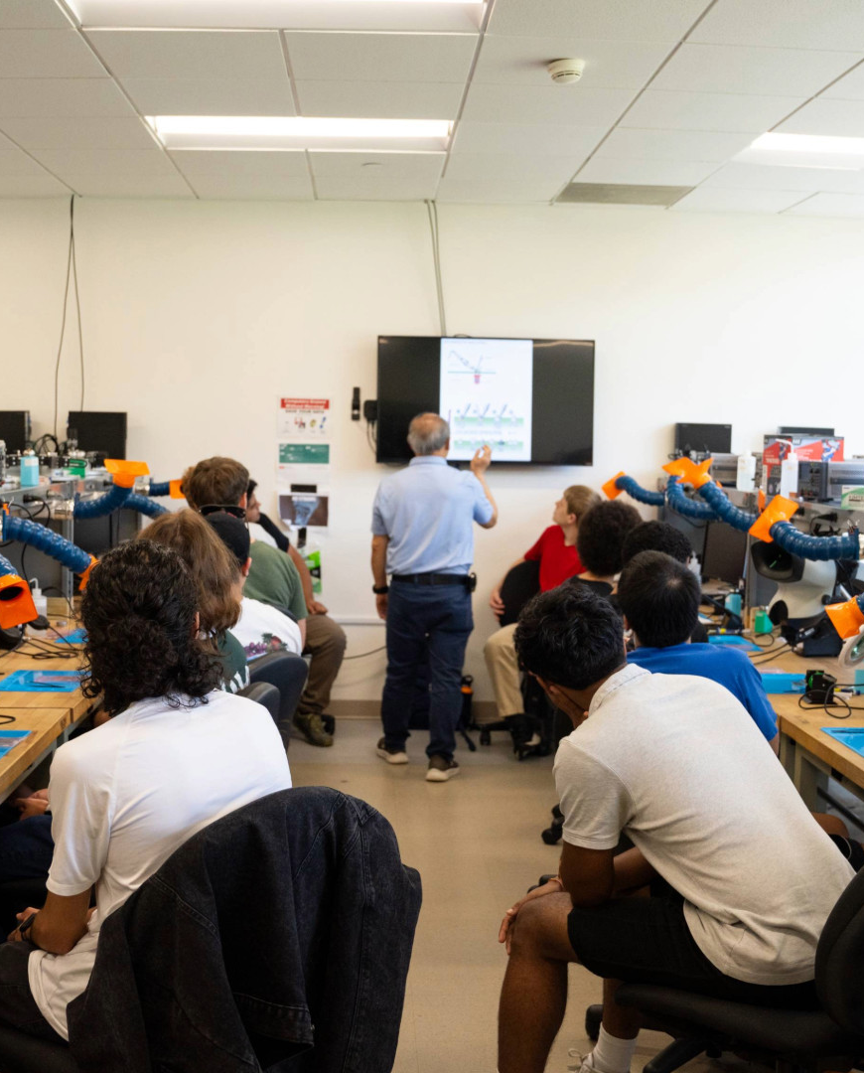
03
THE 4C/ID MODEL
Four-Component Instructional Design
Part 3: Designing Complete Learning Experiences
22

Slide 23
WEEK 03 · LECTURE 5 & 6
What Is the 4C/ID Model?
4C/ID stands for Four-Component Instructional Design
Created by Jeroen van Merriënboer for complex learning
It breaks learning into four connected parts
The model helps designers create complete educational experiences
It is especially useful for skills-based and professional training
THE FOUR COMPONENTS
1
2
Learning Tasks
Supportive Info
3
4
Procedural Info
Part-Task Practice
All four components are connected and work together to create a complete learning experience.
EXPLANATION
4C/ID is like a recipe with four ingredients. Each ingredient is essential, and together they create a complete learning meal.
Complete Learning Design
REAL-WORLD EXAMPLE
Medical training programs use 4C/ID to design courses that teach both knowledge and practical skills together.
23

Slide 24
WEEK 03 · LECTURE 5 & 6
Component 1 — Learning Tasks
Learning tasks are real-world problems students must solve
They should start simple and become more complex over time
Each task gives students a chance to practice the whole skill
Tasks must be authentic — like problems in the real world
This is the heart of the 4C/ID model — learning by doing
TASK COMPLEXITY LADDER
Simple Task (Guided)
Medium Task (Some Help)
Complex Task (Independent)
EXPLANATION
Instead of memorizing facts, students solve real problems. It is like learning to cook by actually cooking, not just reading recipes.
Real-World Task (Mastery)
REAL-WORLD EXAMPLE
A coding bootcamp where students build real apps from day one, starting with simple projects and advancing to complex ones.
24

Slide 25
WEEK 03 · LECTURE 5 & 6
Component 2 — Supportive Information
Supportive information helps students understand HOW to approach tasks
It includes concepts, principles, and theories related to the task
This information is presented before or during task practice
It helps students build a mental model of the subject
Good supportive information makes problem-solving easier
THE GUIDEBOOK ANALOGY
Supportive Info = Guidebook
Concepts and theories
Principles and frameworks
EXPLANATION
Mental models for problem-solving
Supportive information is like a guidebook for a journey. It does not tell you every step, but it helps you understand the landscape and make good decisions.
Better Problem-Solving
REAL-WORLD EXAMPLE
Before a nursing simulation, students learn about patient care principles and medical theory that will help them during the practice exercise.
25

Slide 26
WEEK 03 · LECTURE 5 & 6
Component 3 — Procedural Information
Procedural information tells students exactly HOW to do something
It includes step-by-step instructions, rules, and formulas
This information is given just when students need it (just-in-time)
It helps students perform tasks correctly without guessing
As students practice, they memorize these procedures
JUST-IN-TIME FLOWCHART
Student starts a task
Needs help? → Show procedure
Student follows the steps
EXPLANATION
Procedural information is like GPS directions. You get them right when you need to turn, not at the beginning of the trip.
Procedure becomes automatic
REAL-WORLD EXAMPLE
Just-In-Time Delivery
A photo editing tutorial that shows keyboard shortcuts right when the student needs to use that specific tool.
26

Slide 27
WEEK 03 · LECTURE 5 & 6
Component 4 — Part-Task Practice
Part-task practice helps students master difficult sub-skills
Some skills need to be practiced until they become automatic
This component gives repeated practice for challenging parts
Once sub-skills are automatic, students can focus on the big picture
Practice should be repeated until the skill feels natural
PRACTICE LOOP DIAGRAM
Repeat Until Automatic
Practice Sub-Skill
Check Accuracy
EXPLANATION
Mastered!
Not yet? Retry
Part-task practice is like a basketball player practicing free throws over and over. Eventually, it becomes automatic and they can focus on game strategy.
Skill Becomes Automatic
REAL-WORLD EXAMPLE
Language learning apps like Duolingo repeat vocabulary drills until words are memorized, then move to sentence building.
27

Slide 28
WEEK 03 · LECTURE 5 & 6
Putting It All Together — The 4C/ID in Action
All four components work together in a complete learning design
Learning tasks provide the main structure
Supportive information helps students understand
Procedural information guides their actions
Part-task practice builds automatic skills
COMPLETE 4C/ID MODEL
Learning Tasks
Foundation
Supportive Info
Blueprint
Procedural Info
Instructions
Part-Task Practice
Repetition
EXPLANATION
Powerful Learning Experience
Think of 4C/ID like building a house: tasks are the foundation, supportive info is the blueprint, procedural info is the manual, practice is repeating steps.
House Analogy:
Foundation + Blueprint + Manual + Practice
= A Complete, Well-Built House
REAL-WORLD EXAMPLE
A flight simulator training program combines all four: realistic flights (tasks), aviation theory (supportive), checklists (procedural), and emergency drill repetitions (practice).
28

Slide 29
WEEK 03 · LECTURE 5 & 6
Quick Recap — Key Takeaways
Cognitive Load Theory: Keep content simple, remove distractions
Text + Picture Integration: Combine visuals and text wisely
4C/ID Model: Use real tasks, provide support, practice sub-skills
Always design with the learner's brain in mind
Good multimedia design makes learning easier, not harder
Cognitive Load Theory
Respect the brain's limits. Remove distractions. Focus on what matters for learning.
Integrated Models
Text and visuals are a team. Keep them close, keep them simple, avoid redundancy.
EXPLANATION
These three theories are your toolkit for creating multimedia that actually works. Remember: simple, connected, and practice-focused.
4C/ID Model
Real tasks, supportive info, just-in-time guidance, and repeated practice.
REAL-WORLD EXAMPLE
The best online courses (Coursera, LinkedIn Learning) apply all these principles — short videos, clear visuals, real projects, and repeated practice.
29

Slide 30

WEEK 03 · LECTURES 5 & 6
DESIGN BETTER. TEACH BETTER.
Apply these theories to create multimedia that truly helps learners learn.
Remember: Start with the learner, not the content.
Keep It Simple
Use Visuals + Text
Design for Practice
Cognitive Load Theory · Integrated Models · 4C/ID Model

